Slide 1
Interconnection networks
Characteristic of multiprocessor system – ability of each processor to share a set of main memory modules and I/O devices. This sharing capability is provided through a set of 2 interconnection n/ws.
One b/w the processor and memory modules
other b/w processors and I/o subsystem.

Slide 2
Time shared or common bus
The simplest interconnection system for multiple processors is a common communication path connecting all of the functional units.
eg of a multiprocessor system using a common communication path

Slide 3
Common path is called a time shared or common bus.
---is the least complex and easiest to reconfigure.
Such an interconnection n/w is a passive unit having no active components such as switches.
Transfer operations are controlled completely by the bus interfaces of the sending and receiving units. Since the bus is a shared resource, a mechanism must be provided to resolve contention.
An eg of the time shared bus is the PDP -11.

Slide 4
The single bus organization is quite reliable and relatively inexpensive, it does introduce a single critical component in the system that can cause complete system failure as a result of a malfunction in any of the bus interface circuits.
System expansion by adding more processors or memory increases the bus contention, which degrades system throughput and increases arbitration logic.
The total overall transfer rate within the system is limited by the bandwidth and speed of this single path.

Slide 5
An extension of the single path organization to 2 unidirectional paths.

Slide 6
Multiple bidirectional buses can be used to permit multiple simultaneous bus transfers.

Slide 7
Algorithms for bus arbitration
Static priority algorithm
Digital buses assign unique static priorities to the requesting devices.
When multiple devices concurrently request use of the bus, device with the highest priority is granted access to it.
This approach is implemented using a scheme called daisy chaining, in which all services are effectively assigned static priorities according to their locations along a bus grant control line.

Slide 8
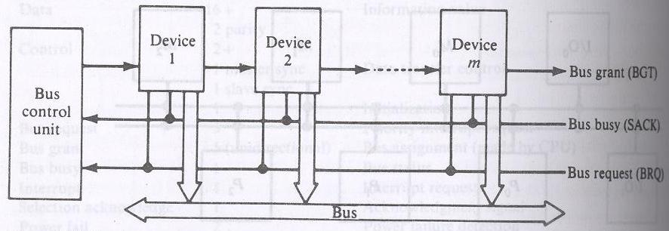
Static daisy chain implementation of a system bus

Slide 9
Device close to the central bus controller is assigned the highest priority.
Requests are made on a common request line, BRQ. The central bus control unit propagates a bus grant signal BGT if the acknowledge signal SACK indicates that the bus is idle.

Slide 10
Fixed time slice algorithm
This divides the available bus band width into fixed length time slices that are then sequentially offered to each device in a round robin fashion. Should the selected device elect not to use the time slice, the time slice remains unused by any device.
The technique is called fixed time slicing (FTS) or time division multiplexing (TMD).

Slide 11
Dynamic priority algorithm
----LRU(least recently used)
----RDC(rotating daisy chain)
The LRU algorithm gives the highest priority to the requesting device that has not used the bus for the longest interval. This is accomplished by reassigning priorities after each bus cycle.
In the daisy chain scheme all devices are given static and unique priorities on a bus grant line emanating from a central controller.

Slide 12
In the RDC scheme, no central controller exists and the bus grant line is connected from the last device back to the first in a closed loop. Whichever device is granted access to the bus serves as the bus controller for the following arbitration.

Slide 13
The FCFS algorithm
Requests are honored in the order received. Scheme is symmetric because it favors no particular processor or device on the bus; thus it load balances the bus requests.
2 difficult reasons to implement FCFS
Mechanism to record the arrival order of all pending requests
It is always possible for 2 bus requests to arrive within a sufficiently small interval.

Slide 14
2 techniques used in bus control algorithms are polling and independent requesting
Polling implementation of a system bus

Slide 15
In a bus controller that uses polling, the bus grant signal, BGT of the static daisy chain is replaced by a set of [log2m] polling lines. The set of poll lines is connected to each of the devices.
On a bus request, the controller sequences through the device address by using the poll lines. When a device Di which requested access recognizes its address, it raises the SACK line.

Slide 16
The bus control unit acknowledges by terminating the polling process and Di gains access to the bus. The access is maintained until the device lowers the SACK line.
The priority of a device is determined by its position in the polling sequence.
In the independent requesting technique, a separate bus request (BRQ) and BGT line are connected to each device i sharing the bus. This requesting technique can permit the implementation of LRU, FCFS etc.

Slide 17
Independent request implementation of a system bus

Slide 18
Crossbar switch and multiport memories
If the number of buses in a time shared bus system is increased a point is reached at which there is a separate path available for each memory unit. The interconnection network is called a nonblocking crossbar.
Crossbar (nonblocking) switch system organization for multiprocessors

Slide 19
M0
M1
Mm-1
P0
I/O0
Pp-1
I/Od-1
Crossbar non blocking switch system organization

Slide 20
The cross bar switch possesses complete connectivity with respect to the memory modules because there is a separate bus associated with each memory modules.
Therefore the max. no. of transfers that can take place simultaneously is limited by the no. of memory module and the band width speed product of the buses rather than by the no. of paths available.

Slide 21
Characteristic of a system utilizing a crossbar interconnection matrix are the
extreme simplicity of the switch to functional unit interfaces and
the ability to support simultaneous transfers for all memory units.

Slide 22
In a crossbar switch or multiported device conflicts occur when two or more concurrent requests are made to the same destination device.
Assume that there are 16 destination devices (memory modules)and 16 requestors (processors).
Functional structure of a cross point in a crossbar n/w

Slide 23
Memory
module
Mux
modules
Data
Data
RD/WR
RD/WR
From P0 to P15
addr
addr
Arbitration
module
REQ0
ACK0
Memory
enable
REQ1
ACK1
REQ15
ACK15

Slide 24
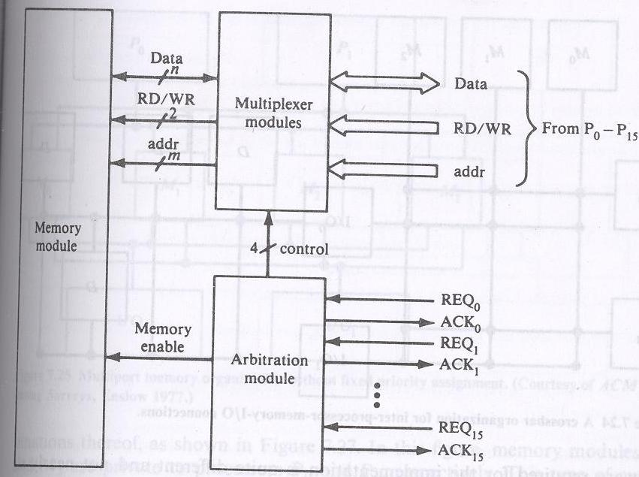

Slide 25
The switch consists of arbitration and multiplexer modules.
Each processor generates a memory module request signal (REQ) to the arbitration unit, which selects the processor with the highest priority. The selection is accomplished with a priority encoder.
The arbitration module returns an acknowledge signal ACK to the selected processor.

Slide 26
After the processor receives the ACK, it initiates its memory operation.
The multiplexer module multiplexes data, address of words within the module and control signals from the processor to the memory module using a 16to 1 multiplexer.

Slide 27
A crossbar organization for inter processor memory I/O connection

Slide 28
M0
M1
M2
D
D
D
P0
I/O0
D
P1
I/O1
Crossbar organization for inter processor memory I/O connection

Slide 29
Multiport memory organization without fixed priority assignment

Slide 30
P0
P1
M0
M1
M2
M3
I/O0
I/O1
Multiport-memory organization without fixed priority assignment

Slide 31
Multiport memory system with assignment of port priorities

Slide 32
P0
P1
0 1
M0
2 3
0 1
M1
3 2
1 0
M2
2 3
1 0
M3
3 2
I/O0
I/O1
Multiport-memory organization with fixed priority assignment

Slide 33
Multiport organizations with private memories

Slide 34
P0
P1
M0
M1
M2
M3
I/O0
I/O1
Multiport-memory organization with private memories

Slide 35
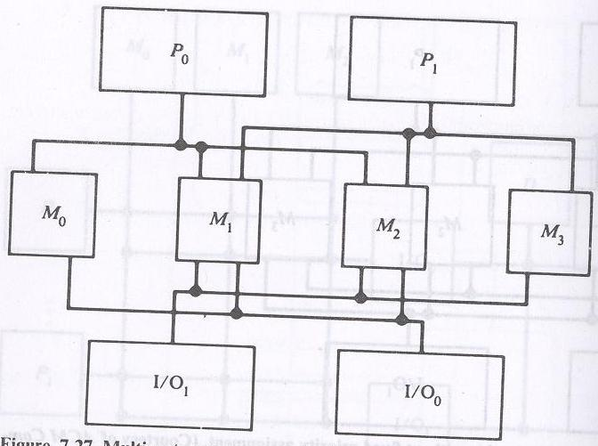

Slide 36
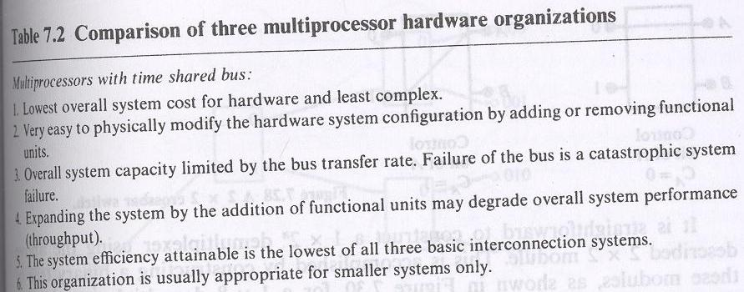

Slide 37
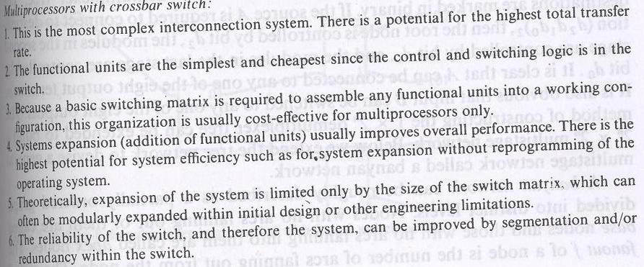

Slide 38
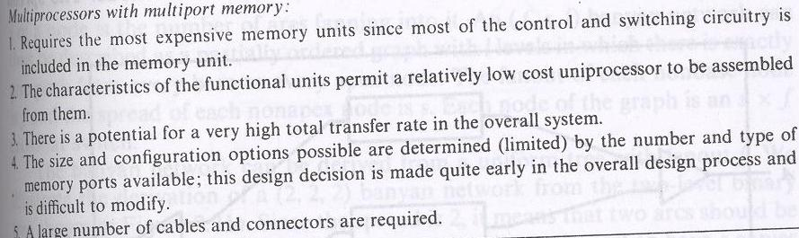

Slide 39
Multistage networks for multiprocessors
Consider the 2 x 2 cross bar switch

Slide 40
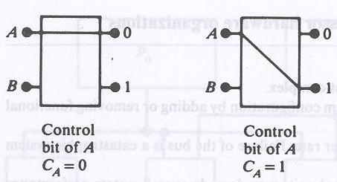

Slide 41
This 2 x 2 switch has the capability of connecting the i/p A to either the o/p labeled 0 or the o/p labeled 1, depending on the value of some control bit C_{A} of the i/p A. If C_{A}=0 the i/p is connected to the upper o/p and if C_{A}=1 the connection is made to the lower o/p.
Terminal B of the switch behaves similarly with a control bit C_{B}. If both i/ps A and B require the same o/p terminal, then only one of them will be connected and the other will be blocked or rejected.

Slide 42
The switch shown is not buffered. In such a switch, the performance may be limited by the switch setup time which is experienced each time with a rejected request is resubmitted.
To improve the performance buffers can be inserted within the switch.

Slide 43
Such a switch has also been shown to be effective for packet switching when used in a multistage n/w.
It is straightforward to construct a 1 x 2^{n} demultiplexer using the 2 x 2 module.
This is accomplished by constructing a binary tree of the modules is shown for a 1 x8 demultiplexer tree.

Slide 44
A banyan n/w can roughly be described as a partially ordered graph divided into distinct levels. Nodes with no arcs faning out of them are called base nodes and those with no arcs faning into them are called apex nodes.
The fanout f of a node is the no. of arcs faning out from the node. The spread s of a node is the no. of arcs faning into it.

Slide 45
An (f,s,l) Banyan n/w can thus be described as a partially ordered graph with l levels in which there is exactly one path from every base to every apex node. The fanout of each nonbase node is f and the spread of each nonapex node is s. Each node of the graph is an s x f crossbar switch.

Slide 46
A delta network is defined as a^{n} x b^{n} switching n/w with n stages consisting of a x b crossbar modules.

Slide 47
Performance of interconnection n/ws
Bandwidth is expressed in the avg. no. of memory requests accepted per cycle.
A cycle is defined as the time it takes for a request to propogate through the logic of the n/w + the time needed to access a memory word + the time used to return through the n/w to the source.

Slide 48
Analyze a p x m crossbar n/ws and delta n/ws for processor-memory interconnections. Do not distinguish the read or write cycles in this analysis.
The analysis is based on the following assumptions:
Each processor generates random and independent requests for a word in memory. The requests are uniformly distributed over all memory modules.

Slide 49
At the beginning of every cycle, each processor generates a new request with a probability r. Thus r is also the avg. no. of requests generated per cycle by each processor.
3. The requests which are blocked are ignored; that is the requests issued at the next cycle are independent of the requests blocked.

Slide 50
Process 0
Language Features to Exploit Parallelism
Fork A,J,3
A
Process 0
Fork B
B
Join J
Process 1
Process 2
Join J
Join J
J
J+1
Process I
I ɛ |0,1,2|

Slide 51
Precedence graph of the concurrent program
S0
S1
S2
Sn
Sn+1

Slide 52
Precedence graph of concurrent nested process
S0
S2
S1
S3
S4
S5
S7
S6
S8

Slide 53
A1
I=0
PREP
Parfor I =1 until n do
Begin
A2
i=i+1
A3
If i>n GOTO A6
End
A4
AND( A2)
A5
BEGINS
END for i
A6
JOIN

